Slide 1
University Physics, lecture 16, still Lesson 10: Mechanical waves
Teacher: Dr. Paul Briard

Slide 2
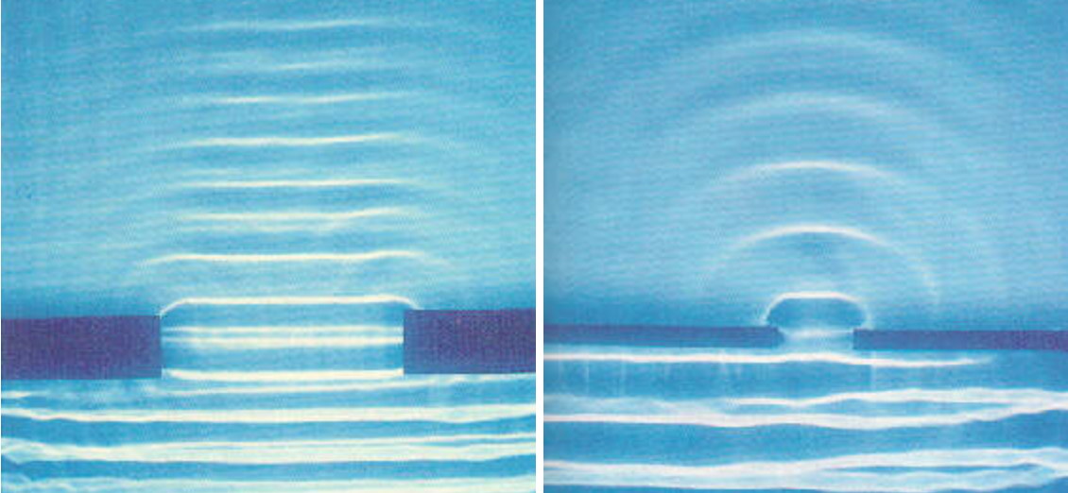
Introduction to the diffraction and Huygens’s principle
Apres l’ouverture, les ondes n’ont la meme forme
Demander ce qu’il se passait si l’ouverture etait encore plus petites => ondes circulaires
Conclure: tous les points du front d’ondre peuvent etre vu par des sources d’ondes secondaire (meme s’il n’y a pas de vibration qui y est cree)
https://sites.google.com/a/simplescience.info/www/science/vibrationsproducewaves
Diffraction of waves at the surface of water by an aperture

Slide 3
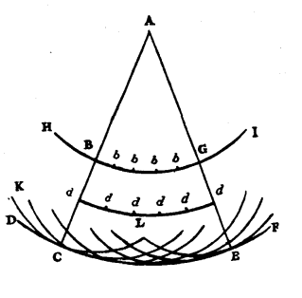
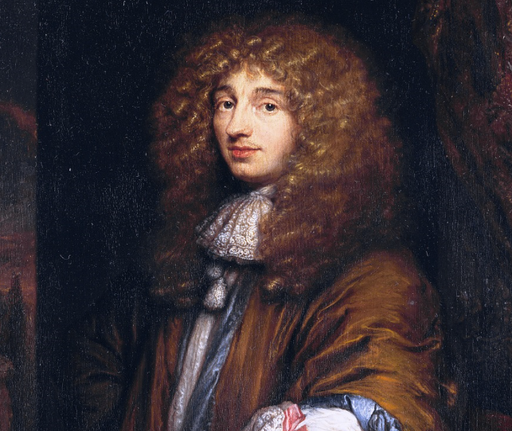
Huygens’s principle
The Huygens’s principle has been described by Christiaan Huygens (1629-1695).
In 1678, he propose in [1] to describe the light as waves and explain the propagation of light using this principle: each point of the wave front is a source of a secondary wave (or wavelet).
A scheme drawn by Huygens [1 pp. 20]
http://www.thefamouspeople.com/profiles/christiaan-huygens-4703.php
Christiaan Huygens
[1] Christiaan Huygens, Traité de la Lumière (1678), an English translation can be found in Gutemberg project website :http://www.gutenberg.org/files/14725/14725-h/14725-h.htm

Slide 4
Huygens’s principle
Huygens’s principle: Every point of the wave front is a source of a secondary waves, named wavelets (the source is named secondary source). The resultant wave is determined as the sum of all the secondary waves.
Examples:
Primary source of the wave
Propagation of circular or spherical waves from a source point:
A secondary source
2D propagation of the wave (such as waves at the surface of water): the wave fronts of wavelets are circular
3D propagation of the wave (such as the sound): the wave fronts of the wavelets are spherical

Slide 5
Huygens’s principle
Huygens’s principle: Every point of the wave front is a source of a secondary waves, named wavelets (the corresponding source is named secondary source). The resultant wave is determined as the sum of all the secondary waves.
Examples:
A point of the wave front seen as a secondary source
Propagation of linear or plane waves (far to a source point)
A linear or plane wave front

Slide 6
Huygens’s principle
We must also consider the directions of propagation of the wave, then :
Propagation of linear or plane waves (far to a source point)
Propagation of circular or spherical waves from a source point:

Slide 7
Shape of wave fronts after an aperture
Aperture
Wave fronts

Slide 8
Shape of wave fronts after a slit
Aperture (slit)
Wave fronts
The set of all the points of the aperture can be seen as a secondary source

Slide 9
Shape of wave fronts after a slit
Aperture (slit)
Wave fronts

Slide 10
Shape of wave fronts after a slit
Aperture (slit)
Wave fronts

Slide 11
Shape of wave fronts after a slit
Aperture (slit)
Wave front after the aperture
Wave fronts

Slide 12
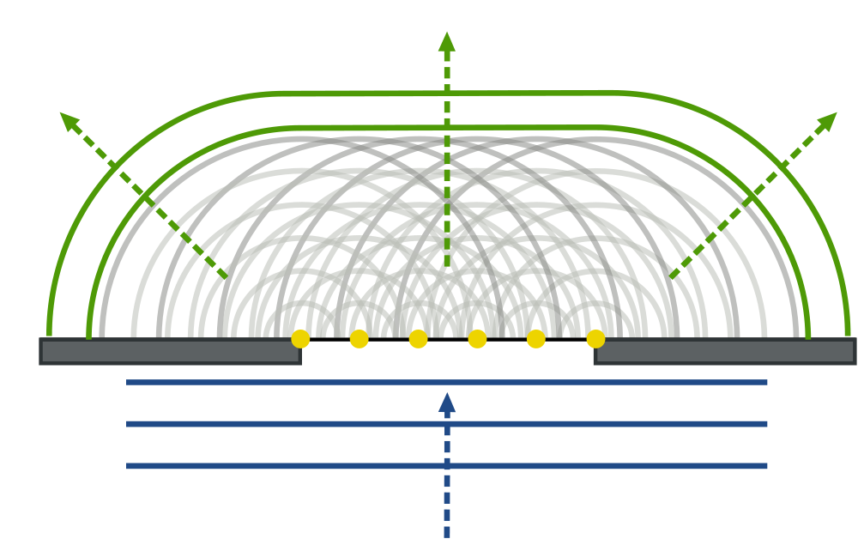
Shape of wave fronts after an aperture

Slide 13
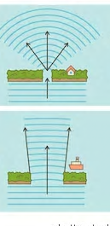
The diffraction
When a wave pass through a narrow gap (such as a slit or a hole), the wave is diffracted: the wave is bended (its wave fronts are bended) and it spreads out.
Narrow gap: passage etroit

Slide 14

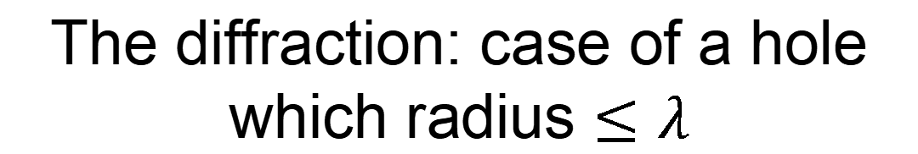
The diffraction: case of a hole which radius $≤λ$
If the aperture is quite small (aperture radius $≤λ$) the wave fronts of the diffracted waves are spherical (in the incident wave propagates in 3 dimensions). The aperture can also be seen as a secondary source point.
Direction of propagation
Narrow gap: passage etroit
spherical wave fronts
Aperture
Plane wave fronts

Slide 15
The diffraction: case of a hole which radius $≤λ$
Case of 2D waves (for instance waves at the surface of water)
Direction of propagation
Narrow gap: passage etroit
Circular wave fronts
Aperture
Linear wave fronts

Slide 16
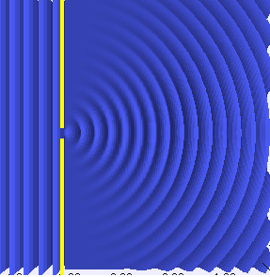
The diffraction: case of a hole which radius $≤λ$
Simulation: cliquer sur le site pour voir la simulation
Numerical simulation of diffraction by an aperture
https://devdude.me/blimg/dblSlit/waterwavesdiffraction.gif

Slide 17
The one million dollar question !
Je peux proposer unerecompense du style petit pain si j’en ait
What happens if there is two apertures instead of one ?

Slide 18
Here was just an introduction, there are equations which describe the diffraction of a wave by an aperture, you will see this later.

Slide 19
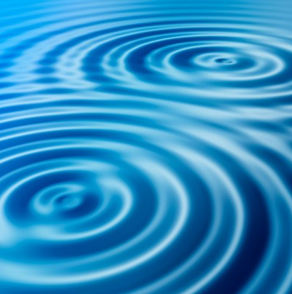
3. Interferences between mechanical waves
http://physics.tutorvista.com/waves/wave-interference.html

Slide 20

Interference between waves
If two waves (or more) with same angular frequency overlap at the same point of space we say they interfere together. This phenomenon is named interferences.
Example of two waves propagating in the $+x$ direction with same angular frequency and same wave number:
$$u_{A}\left(x,t\right)=A\cos\left(ωt−kx+φ_{A}\right)$$
$$u_{B}\left(x,t\right)=B\cos\left(ωt−kx+φ_{B}\right)$$
The resultant (or superposition) is:
$u\left(x,t\right)=u_{A}\left(x,t\right)$+ $u_{B}\left(x,t\right)$

Slide 21
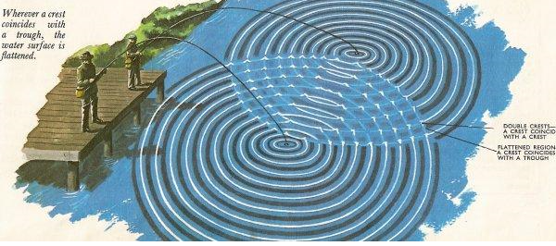
Interference between waves
https://s3.amazonaws.com/classconnection/791/flashcards/8083791/jpg/interference_water_waves-14C9C12D19A1F1887F3.jpg

Slide 22
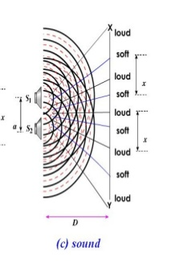
Interference between waves
Reprendre deux diapasons mais a meme frequence
Entend-on
La difference selon ou on se trouve
Expliquer ce qu’est la pression ? Avec une bouteille d’eau vide
All the mechanical waves can interfere:
Waves at the surface of water
Sound waves
Transverse waves on a string
…
https://image.slidesharecdn.com/1-131012090818-phpapp02/95/15-interference-50-638.jpg?cb=1381568984
Interferences between sound waves produced by speakers

Slide 23
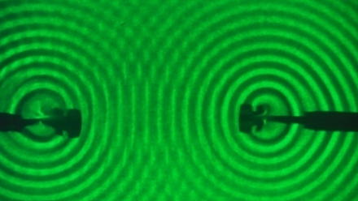
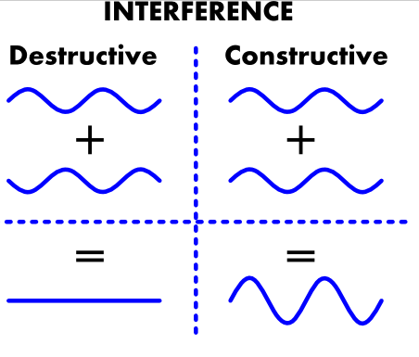
Constructive and destructive interference between sinusoidal waves
If the sinusoidal waves have the same angular frequency:
Waves in antiphase
Waves in phase
Interference between sinusoidal waves at the surface of water
http://www.gwoptics.org/images/ebook/interference-explain.png
In this example, the waves have same amplitude but they can have different amplitudes
http://www.didaktik.physik.uni-erlangen.de/quantumlab/english/interference/Grundlagen/Wasser-Interferenz.jpg
The interference between two sinusoidal waves on a point is similar to the superposition of two simple harmonic motions which have the same angular frequency.

Slide 24
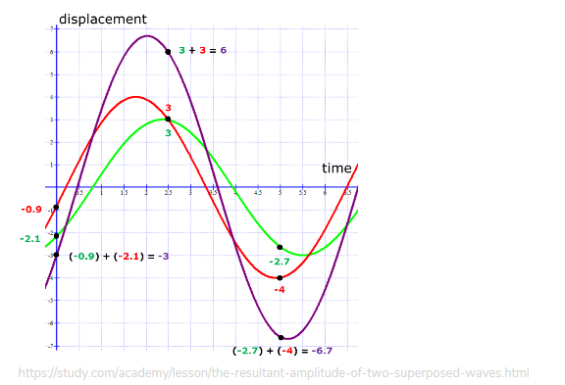
Principle of superposition of waves
“Principle of superposition states that when two or more waves meet at a point, the resultant wave has a displacement which is the algebraic sum of the displacements of each wave.” (if the perturbation is a displacement)[2]
https://socratic.org/questions/what-is-the-principle-of-superposition-of-waves
[2]

Slide 25
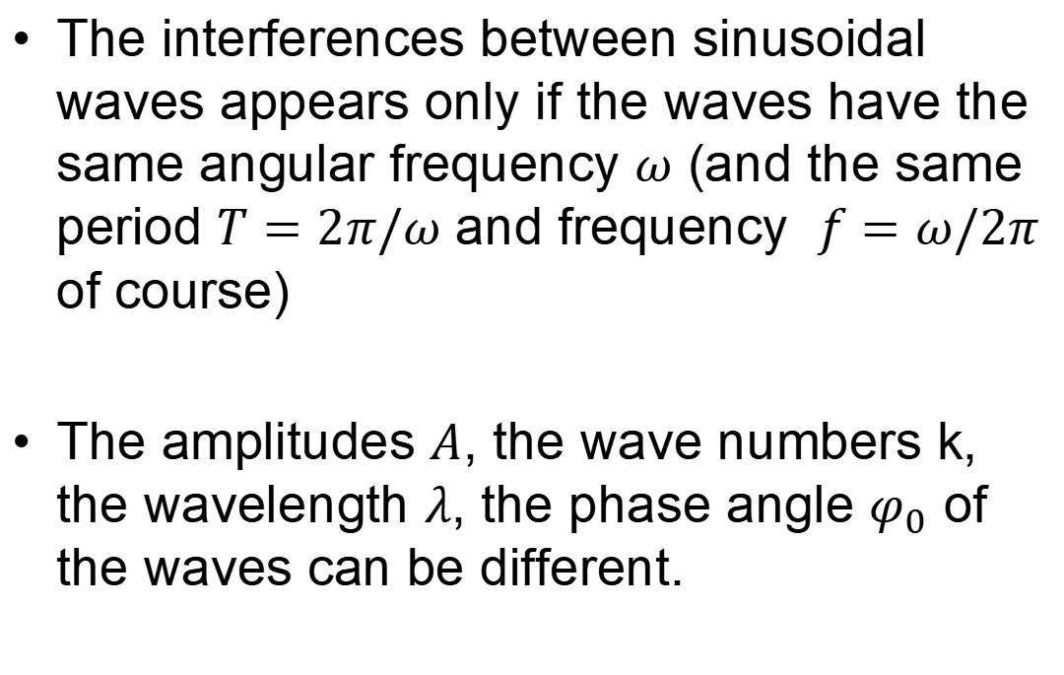
Interferences between waves
The interferences between sinusoidal waves appears only if the waves have the same angular frequency $ω$ (and the same period $T=2π/ω$ and frequency $f=ω/2π$ of course)
The amplitudes $A$, the wave numbers k, the wavelength $λ$, the phase angle $φ_{0}$ of the waves can be different.

Slide 26








Ex: Interferences between 2 spherical waves generated by two source points
Perturbation at source $S_{1}$:
$$r_{1}$$
$$P$$
$$u_{1}\left(t\right)=A_{1}\cos\left(ωt+φ_{1}\right)$$
$$S_{1}$$
Perturbation propagated from $S_{1}$ to P:
$$u_{P,1}\left(t\right)=A_{1}\cos\left(ωt−kr_{1}+φ_{1}\right)$$
$$r_{2}$$
Perturbation at the source $S_{2}$
$$S_{2}$$
$$u_{2}\left(t\right)=A_{2}\cos\left(ωt+φ_{2}\right)$$
Perturbation propagated from $S_{2}$ to P:
$$u_{P,2}\left(t\right)=A_{2}\cos\left(ωt−kr_{2}+φ_{2}\right)$$
The two sinusoidal waves generated have the same angular frequency $ω$ and the same wave number $k$. The perturbation in the two sources is a sinusoidal oscillation.
1. What is the phase difference $∆φ$ between the two sinusoidal waves at P ? (2 minutes)

Slide 27


Ex: Interferences between 2 spherical waves generated by two source points
Perturbation propagated from $S_{1}$ to P:
$$r_{1}$$
$$P$$
$$S_{1}$$
$$u_{P,1}\left(t\right)=A_{1}\cos\left(ωt−kr_{1}+φ_{1}\right)$$
Perturbation propagated from $S_{2}$ to P:
$$u_{P,2}\left(t\right)=A_{2}\cos\left(ωt−kr_{2}+φ_{2}\right)$$
$$r_{2}$$
$$S_{2}$$
1. What is the phase difference $∆φ$ between the two sinusoidal waves at P ?
$$∆φ=\left(ωt−kr_{2}+φ_{2}\right)−\left(ωt−kr_{1}+φ_{1}\right)$$
$$∆φ=k\left(r_{1}−r_{2}\right)+φ_{2}−φ_{1}$$
(You can find the result $∆φ=k\left(r_{2}−r_{1}\right)+φ_{1}−φ_{2}$)

Slide 28
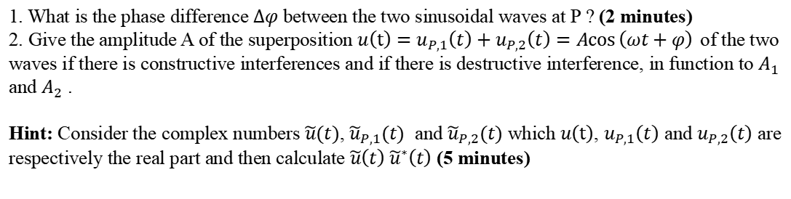
Ex: Interferences between 2 spherical waves generated by two source points
Perturbation at source $S_{1}$:
$$r_{1}$$
$$P$$
$$u_{1}\left(t\right)=A_{1}\cos\left(ωt+φ_{1}\right)$$
$$S_{1}$$
Perturbation propagated from $S_{1}$ to P:
$$u_{P,1}\left(t\right)=A_{1}\cos\left(ωt−kr_{1}+φ_{1}\right)$$
$$r_{2}$$
Perturbation at the source $S_{2}$
$$S_{2}$$
$$u\left(t\right)=A_{2}\cos\left(ωt+φ_{2}\right)$$
Perturbation propagated from $S_{2}$ to P:
$$u_{P,2}\left(t\right)=A_{2}\cos\left(ωt−kr_{2}+φ_{2}\right)$$
The two sinusoidal waves generated have the same angular frequency $ω$ and the same wave number $k$. The perturbation in the two sources is a sinusoidal oscillation.
1. What is the phase difference $∆φ$ between the two sinusoidal waves at P ? (2 minutes)
2. Give the amplitude A of the superposition $u\left(t\right)=u_{P,1}\left(t\right)+u_{P,2}\left(t\right)=A\cos\left(ωt+φ\right)$of the two waves if there is constructive interferences and if there is destructive interference, in function to $A_{1}$ and $A_{2}$ .
Hint: Consider the complex numbers $\tilde{u}(t)$, ${\tilde{u}}_{P,1}(t)$ and ${\tilde{u}}_{P,2}(t)$ which $u\left(t\right)$, $u_{P,1}\left(t\right)$ and $u_{P,2}\left(t\right)$ are respectively the real part and then calculate $\tilde{u}\left(t\right)$ ${\tilde{u}}^{∗}\left(t\right)$ (5 minutes)

Slide 29



Ex: Interferences between 2 spherical waves generated by two source points
Perturbation propagated from $S_{1}$ to P:
$$r_{1}$$
$$P$$
$$S_{1}$$
$$u_{P,1}\left(t\right)=A_{1}\cos\left(ωt−kr_{1}+φ_{1}\right)$$
Perturbation propagated from $S_{2}$ to P:
$$u_{P,2}\left(t\right)=A_{2}\cos\left(ωt−kr_{2}+φ_{2}\right)$$
$$r_{2}$$
$$S_{2}$$
Hint: Consider the complex numbers $\tilde{u}(t)$, ${\tilde{u}}_{P,1}(t)$ and ${\tilde{u}}_{P,2}(t)$ which $u\left(t\right)$, $u_{P,1}\left(t\right)$ and $u_{P,2}\left(t\right)$ are respectively the real part and then calculate $\tilde{u}\left(t\right)$ ${\tilde{u}}^{∗}\left(t\right)$
${\tilde{u}}_{P,1}\left(t\right)=A_{1}e^{i\left(ωt−kr_{1}+φ_{1}\right)}$
${\tilde{u}}_{P,2}\left(t\right)=A_{2}e^{i\left(ωt−kr_{2}+φ_{2}\right)}$
$\tilde{u}\left(t\right)=Ae^{i\left(ωt+φ\right)}$
$$\tilde{u}\left(t\right)={\tilde{u}}_{P,1}\left(t\right)+{\tilde{u}}_{P,2}\left(t\right)=A_{1}e^{i\left(ωt−kr_{1}+φ_{1}\right)}+A_{2}e^{i\left(ωt−kr_{2}+φ_{2}\right)}$$

Slide 30

Ex: Interferences between 2 spherical waves generated by two source points
${\tilde{u}}_{P,1}\left(t\right)=A_{1}e^{i\left(ωt−kr_{1}+φ_{1}\right)}$
${\tilde{u}}_{P,2}\left(t\right)=A_{2}e^{i\left(ωt−kr_{2}+φ_{2}\right)}$
$\tilde{u}\left(t\right)=Ae^{i\left(ωt+φ\right)}$
$$\tilde{u}\left(t\right)={\tilde{u}}_{P,1}\left(t\right)+{\tilde{u}}_{P,2}\left(t\right)=A_{1}e^{i\left(ωt−kr_{1}+φ_{1}\right)}+A_{2}e^{i\left(ωt−kr_{2}+φ_{2}\right)}$$
$$Ae^{i\left(ωt+φ\right)}=A_{1}e^{i\left(ωt−kr_{1}+φ_{1}\right)}+A_{2}e^{i\left(ωt−kr_{2}+φ_{2}\right)}$$
$\tilde{u}\left(t\right)$ ${\tilde{u}}^{∗}\left(t\right)=A^{2}=\left[A_{1}e^{i\left(ωt−kr_{1}+φ_{1}\right)}+A_{2}e^{i\left(ωt−kr_{2}+φ_{2}\right)}\right]{\left[A_{1}e^{i\left(ωt−kr_{1}+φ_{1}\right)}+A_{2}e^{i\left(ωt−kr_{2}+φ_{2}\right)}\right]}^{∗}$
$\tilde{u}\left(t\right)$ ${\tilde{u}}^{∗}\left(t\right)=A^{2}=A_{1}^{2}+A_{2}^{2}+A_{1}e^{i\left(ωt−kr_{1}+φ_{1}\right)}A_{2}e^{−i\left(ωt−kr_{2}+φ_{2}\right)}+A_{1}e^{−i\left(ωt−kr_{1}+φ_{1}\right)}A_{2}e^{i\left(ωt−kr_{2}+φ_{2}\right)}$
$\tilde{u}\left(t\right)$ ${\tilde{u}}^{∗}\left(t\right)=A^{2}=A_{1}^{2}+A_{2}^{2}+A_{1}e^{i\left(kr_{1}+φ_{1}\right)}A_{2}e^{−i\left(−kr_{2}+φ_{2}\right)}+A_{1}e^{−i\left(−kr_{1}+φ_{1}\right)}A_{2}e^{i\left(−kr_{2}+φ_{2}\right)}$
$\tilde{u}\left(t\right)$ ${\tilde{u}}^{∗}\left(t\right)=A^{2}=A_{1}^{2}+A_{2}^{2}+2\cos\left[k\left(r_{1}−r_{2}\right)+φ_{2}−φ_{1}\right]$
$\tilde{u}\left(t\right)$ ${\tilde{u}}^{∗}\left(t\right)=A^{2}=A_{1}^{2}+A_{2}^{2}+2\cos{Δφ}$
$$A=\sqrt{A_{1}^{2}+A_{2}^{2}+2A_{1}A_{2}\cos{Δφ}}$$

Slide 31







Ex: Interferences between 2 spherical waves generated by two source points
$\hat{u}\left(t\right)$ ${\hat{u}}^{∗}\left(t\right)=A^{2}=A_{1}^{2}+A_{2}^{2}+2A_{1}A_{2}\cos{Δφ}$
$$A=\sqrt{A_{1}^{2}+A_{2}^{2}+2A_{1}A_{2}cos{Δφ}}$$
Amplitude A if the interferences are destructive:
$$A=\sqrt{A_{1}^{2}+A_{2}^{2}−2A_{1}A_{2}}$$
The waves are in antiphase
$$\cos{Δφ}=−1$$
$$A=\sqrt{{\left(A_{1}−A_{2}\right)}^{2}}$$
$$Δφ=(2m+1)π$$
$$A=\left|A_{1}−A_{2}\right|$$
With $m$ an integer positive, negative or equal to 0
$$k\left(r_{1}−r_{2}\right)+φ_{2}−φ_{1}=(2m+1)π$$

Slide 32






Ex: Interferences between 2 spherical waves generated by two source points
Amplitude A if the interferences are constructive:
$$A=\sqrt{A_{1}^{2}+A_{2}^{2}+2A_{1}A_{2}cos{Δφ}}$$
$$A=\sqrt{A_{1}^{2}+A_{2}^{2}+2A_{1}A_{2}}$$
The waves are in phase:
$$\cos{Δφ}=1$$
$$A=\sqrt{{\left(A_{1}+A_{2}\right)}^{2}}$$
$$Δφ=2mπ$$
$$A=A_{1}+A_{2}$$
With $m$ an integer positive, negative or equal to 0
$$k\left(r_{1}−r_{2}\right)+φ_{2}−φ_{1} =2mπ$$

Slide 33




Destructive interferences:
$$A=\left|A_{1}−A_{2}\right|$$
if $A_{1}=A_{2}$
$$A=0$$
Constructive interferences:
$$A=A_{1}+A_{2}$$
if $A_{1}=A_{2}$
$$A=2A_{1}=2A_{2}$$
http://www.gwoptics.org/images/ebook/interference-explain.png

Slide 34

About complex numbers and waves
A mechanical wave is the propagation of a perturbation, involving for instance the local pressure or a displacement, which are real numbers.
However, it is often convenient to describe waves by complex numbers.
For instance, the wave:
$$u_{P,1}\left(t\right)=A_{1}\cos\left(ωt−kr_{1}+φ_{1}\right)$$
is the real part of the complex number:
$${\tilde{u}}_{P,1}\left(t\right)=A_{1}e^{i(ωt−kr_{1}+φ_{1})}$$
It is not something easy to understand because the mechanical perturbation are described by real numbers, but this is very useful because many calculations become more easy such as description of interferences or the solving of differential equations.

Slide 35
Standing waves

Slide 36
Introduction
We consider the propagation of a wave along a string attached to a wall. What happens when the wave is at the end of string ? Does-it disappear ?

Slide 37
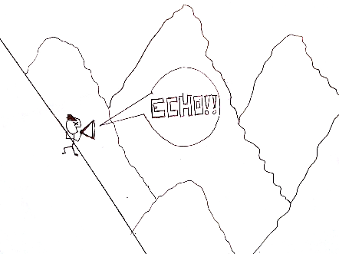
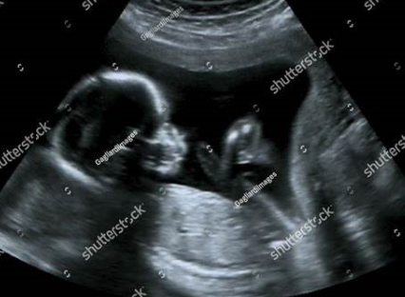
Reflection of a mechanical wave
Mechanical waves can be reflected.
For instance, the sound wave reflected by a surface is called echo:
an echography scan
http://medianthro.org/?m=201501
http://www.shutterstock.com/pic-140518024/stock-photo-obstetric-ultrasound-of-fetus-at-fourth-month-echography-scan.html

Slide 38
Reflection of transverse wave on a string from fixed and free end
Two cases can be considered:
The wave reflects from a fixed end
The wave reflects from a free end
The string is attached
to a wall.
A rod and a ring which permits the free end.

Slide 39
Reflection of a wave from a fixed end
The pulse arrives on the wall.
“pulse” is the name for this kind of wave.

Slide 40
Reflection of a wave from a fixed end
The pulse arrives on the wall.
The string exert an transverse force on the wall. The wall exert the opposite force on the string, which is responsible to the reflected wave
The pulse reflects with inverting

Slide 41
Reflection of a wave from a free end
A rod and a ring which permits the free end.
The pulse arrives on the rod.

Slide 42
Reflection of a wave from a free end
The pulse arrives on the rod.
The rod exert no transverse
Force on the string (unlike the previous case)

Slide 43
Reflection of a wave from a free end

Slide 44




The boundary conditions
The condition at the end of the string (free end or fixed end) is called boundary conditions.
The characteristics of the reflected wave depends to the boundary conditions.
In the case of fixed end,
$$y$$
O
$$x$$
The wave is described by the function
$$y(x,t)$$
Because of the fixed end,
$$y\left(x_{O},t\right)=0$$

Slide 45
The boundary conditions
The reflection of a pulse in a free or fixed end can be compared to the overlap of two pulses propagating in opposite directions.
Here the pulses are inverted with respect to each other (similar with fixed end at O):
O
O
O

Slide 46
The boundary conditions
The reflection of a pulse in a free or fixed end can be compared to the overlap of two pulses propagating in opposite directions.
Here the pulses are inverted with respect to each other (similar with fixed end at O):
O
O
O

Slide 47
The boundary conditions
The reflection of a pulse in a free or fixed end can be compared to the overlap of two pulses propagating in opposite directions.
Here the pulses are not inverted with respect to each other:
O
O
O

Slide 48
The boundary conditions
The reflection of a pulse in a free or fixed end can be compared to the overlap of two pulses propagating in opposite directions.
Here the pulses are not inverted with respect to each other:
O
O
O

Slide 49
End of lecture 16

